Slide 1


Slide 2

Photo by Defence Images - Creative Commons Attribution-NonCommercial License https://www.flickr.com/photos/48399297@N04
Created with Haiku Deck

Slide 3

Photo by Chris Smith/Out of Chicago - Creative Commons Attribution-NonCommercial-ShareAlike License https://www.flickr.com/photos/65315936@N00
Created with Haiku Deck

Slide 4

Photo by Stuck in Customs - Creative Commons Attribution-NonCommercial-ShareAlike License https://www.flickr.com/photos/95572727@N00
Created with Haiku Deck

Slide 5

Photo by paul goyette - Creative Commons Attribution-NonCommercial-ShareAlike License https://www.flickr.com/photos/65414509@N00
Created with Haiku Deck

Slide 6

Photo by Yahoo Inc - Creative Commons Attribution License https://www.flickr.com/photos/99527366@N00
Created with Haiku Deck

Slide 7

Photo by Luis Hernandez - D2k6.es - Creative Commons Attribution License https://www.flickr.com/photos/25062265@N06
Created with Haiku Deck

Slide 8

Photo by JD Hancock - Creative Commons Attribution License https://www.flickr.com/photos/83346641@N00
Created with Haiku Deck

Slide 9

Photo by cesarharada.com - Creative Commons Attribution-NonCommercial-ShareAlike License https://www.flickr.com/photos/27703797@N06
Created with Haiku Deck

Slide 10

Photo by maaco - Creative Commons Attribution-NonCommercial License https://www.flickr.com/photos/22455783@N05
Created with Haiku Deck

Slide 11

Photo by Wayan Vota - Creative Commons Attribution-NonCommercial-ShareAlike License https://www.flickr.com/photos/42925588@N00
Created with Haiku Deck

Slide 12
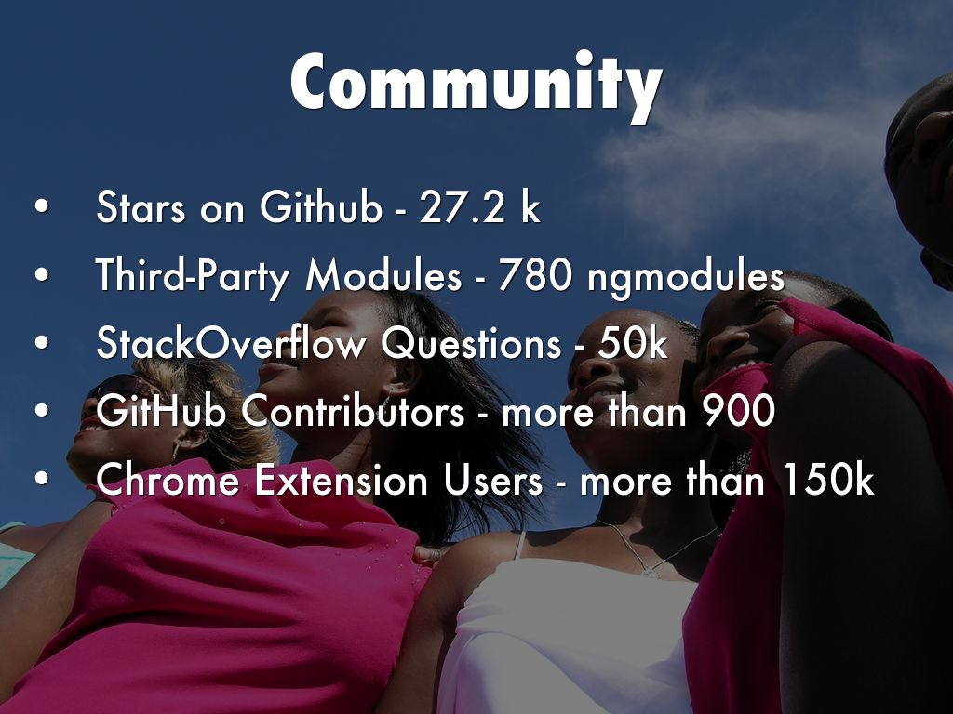
Photo by angela7dreams - Creative Commons Attribution-NonCommercial License https://www.flickr.com/photos/58117789@N00
Created with Haiku Deck

Slide 13

Photo by kevin dooley - Creative Commons Attribution License https://www.flickr.com/photos/12836528@N00
Created with Haiku Deck

Slide 14

Photo by Johan Larsson - Creative Commons Attribution License https://www.flickr.com/photos/38305415@N00
Created with Haiku Deck

Slide 15
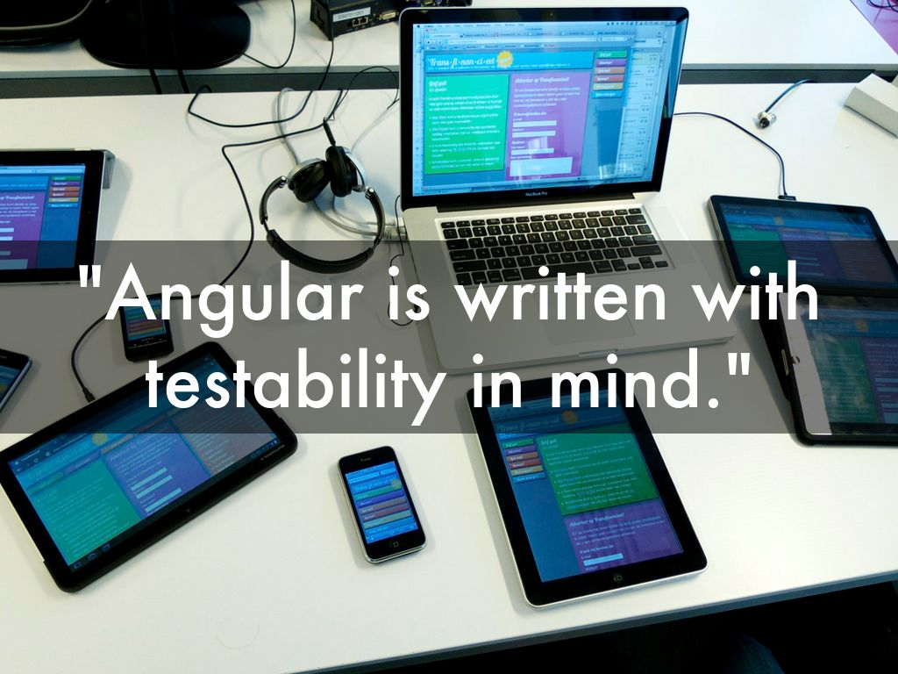
Photo by Peet Sneekes - Creative Commons Attribution-NonCommercial License https://www.flickr.com/photos/48319358@N00
Created with Haiku Deck

Slide 16
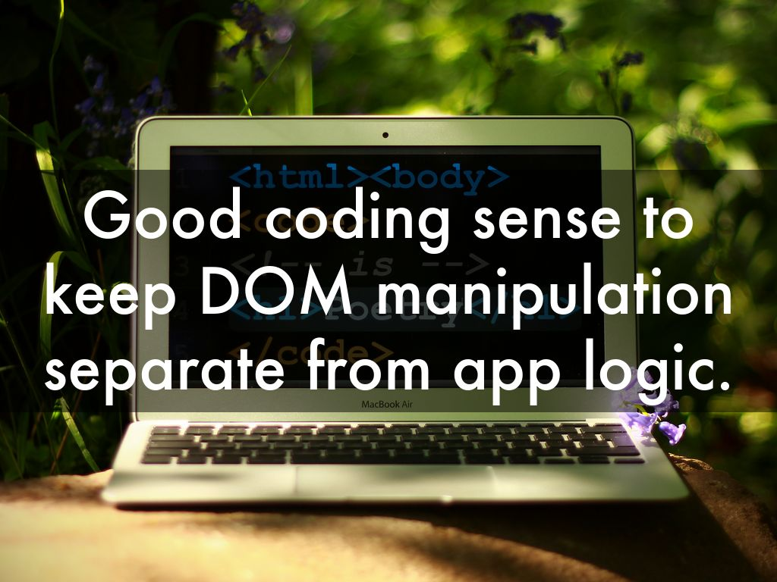
Photo by Foomandoonian - Creative Commons Attribution-NonCommercial-ShareAlike License https://www.flickr.com/photos/38677669@N00
Created with Haiku Deck

Slide 17

Photo by Shinji Nikaru - Creative Commons Attribution-NonCommercial License https://www.flickr.com/photos/32795980@N02
Created with Haiku Deck

Slide 18
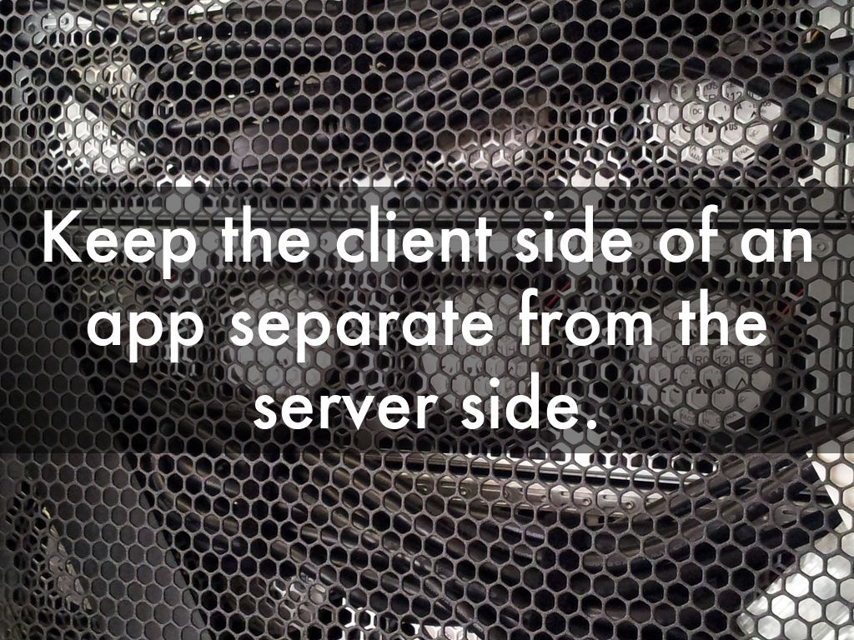
Photo by seeweb - Creative Commons Attribution-ShareAlike License https://www.flickr.com/photos/65475777@N06
Created with Haiku Deck

Slide 19
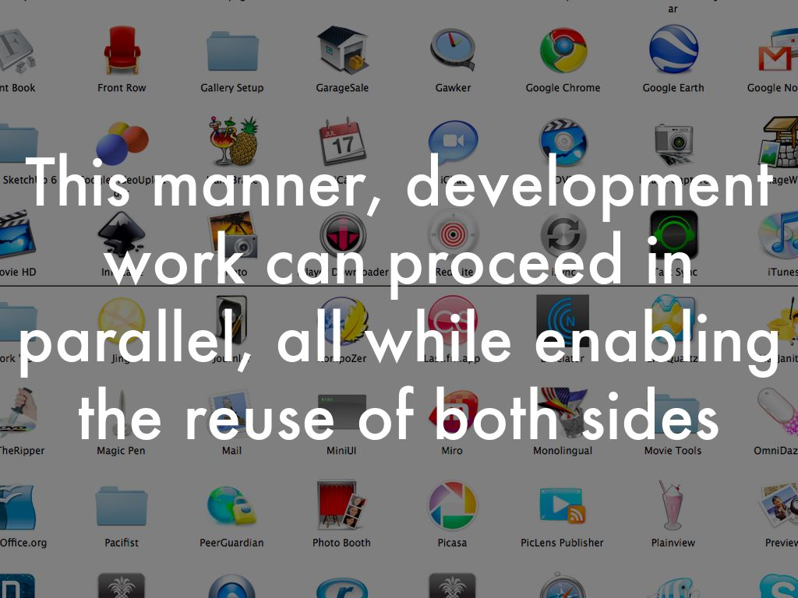
Photo by dougbelshaw - Creative Commons Attribution License https://www.flickr.com/photos/94991702@N00
Created with Haiku Deck

Slide 20

Photo by quentzi - Creative Commons Attribution-NonCommercial-ShareAlike License https://www.flickr.com/photos/63367657@N00
Created with Haiku Deck

Slide 21

Photo by epSos.de - Creative Commons Attribution License https://www.flickr.com/photos/36495803@N05
Created with Haiku Deck

Slide 22

Photo by Sean MacEntee - Creative Commons Attribution License https://www.flickr.com/photos/18090920@N07
Created with Haiku Deck

Slide 23

Photo by alisdair - Creative Commons Attribution License https://www.flickr.com/photos/41143865@N00
Created with Haiku Deck

Slide 24

Photo by JD Hancock - Creative Commons Attribution License https://www.flickr.com/photos/83346641@N00
Created with Haiku Deck

